Slide 1
1) PATWARDHAN SAYUJA SUMUKH (220960925033) 2) TALELE TUSHAR SANJAY (220960925049) 3) THOPATE GIRISH PRAKASH (220960925050) 4) WAGH ROHIT VILAS (220960925051) 5) ZOPE JAYESH PRAKASH (220960925052)
Group No: 10
Group Members:

Slide 2
A Machine Learning- Based Water Potability Prediction Model.
Project Name

Slide 3
Problem Statement
Natural Water resources are facing threat or becoming impure and unsafe for drinking. Hence it is mandatory to check the water potability before Human Consumption. So our aim is to check the water potability using various ML Algorithms and thereby comparing the accuracy obtained by various algorithms.

Slide 4
Literature Survey
This research explores the methodologies that have been employed to help solve problems related to water quality. Typically, conventional lab analysis and statistical analysis are used in research to aid in determining water quality, while some analyses employ machine learning methodologies to assist in finding an optimized solution for the water quality problem.Chidanand Patil et.al [02] carried out Physical, chemical, bacteriological analysis of water samples. The parameters analysed during the study period were pH, Total dissolved solids (TDS),Total Hardness, Nitrate, Most Probable Number (MPN) and heavy metal such as Lead using standard laboratory procedures. The pH ranged from 6.01 to 7.3 indicating acidic in nature. Mona A. Hagras et.al [03] to assess the quality of groundwater and to characterize the hadrochemical characteristics of the groundwater in Punjab, groundwater samples were collected from different cities of Punjab Province and analysed for 28 water quality parameters Groundwater suitability for domestic and irrigation purposes was assessed by using WHO and USDA standards. SAR values and the sodium percentage (Na%) in locations indicate that majority of the groundwater samples are suitable for drinking as well as irrigation. This investigational study indicates that water in Delhi is unsafe for human consumption due to presence of both bacterial and chemical contamination.

Slide 5
References
Dinesh kumar tank and c. p. Singh chandel, “Analysis of the major ion constituents in groundwater of Jaipur city”, Nature and Science, 2010;8(10), 1-7
Chidanand Patil, Shreekant Narayanakar and Arjun Virupakshi, “Assessment of Groundwater Quality Around Solid Waste Landfill Area - A Case Study, International Journal of Innovative Research in Science, Engineering and Technology, Vol. 2, Issue 7, July 2013, pp. 3131-3136.
Mona A. Hagras Assistant Professor, Irrigation &Hydraulics Department, Faculty of Engineering, Ain Shams University, Cairo, Egypt

Slide 6
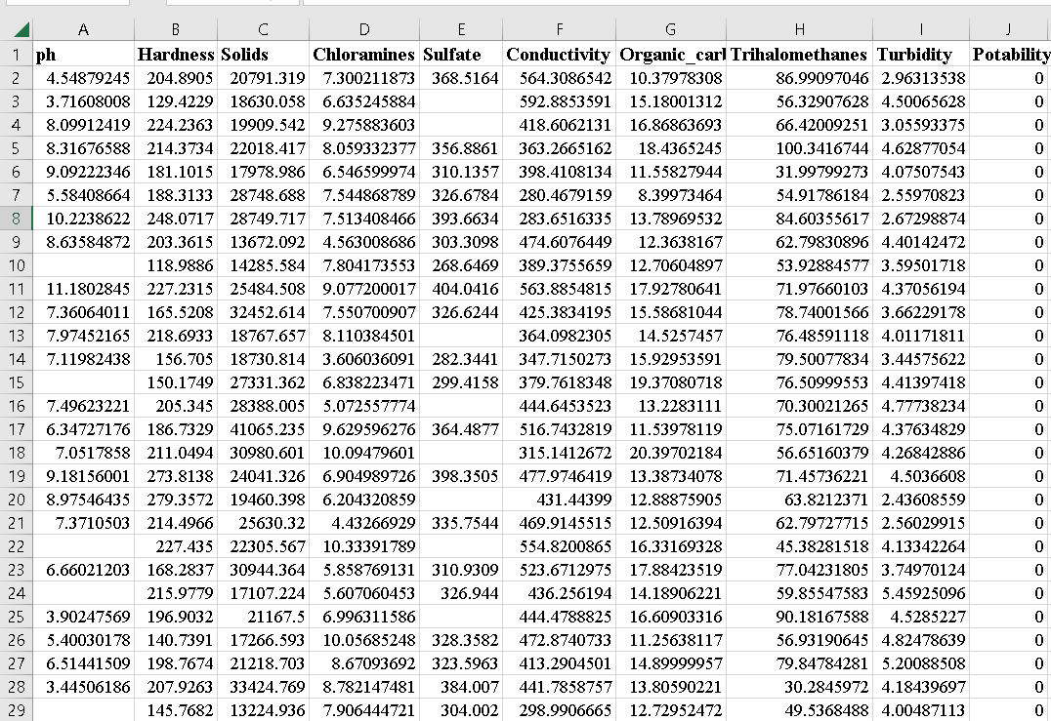
Dataset

Slide 7
Methodology
Data Collecting
Data Reading & Understanding
Data Pre-processing
Exploratory Data Analysis (EDA)
Choosing the appropriate algorithms
Modelling
Checking accuracy
Conclusion

Slide 8
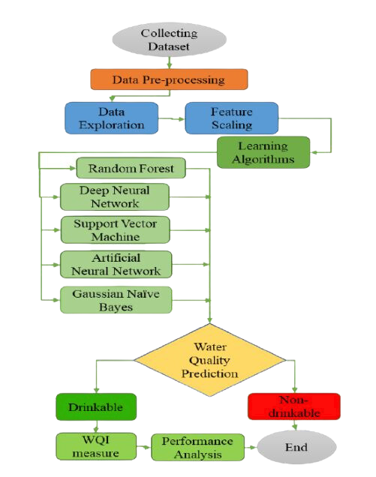
Flowchart

Slide 9
Thank You…

